Slide 1
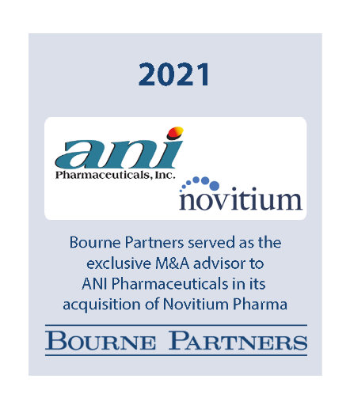
Case Study – ANI Pharmaceuticals, Inc.
ANI PHARMACEUTICALS
ANI Pharmaceuticals, Inc. is a publicly-traded specialty pharmaceutical company that develops, manufactures, and markets branded and generic prescription pharmaceuticals in the United States and Canada. The company was founded in 2001 and is headquartered in Baudette, Minnesota.
NOVITIUM PHARMA
Novitium Pharma LLC is a privately-owned pharmaceutical company that specializes in development, manufacturing, and distribution of niche generic products spanning a diverse range of dosage forms and therapeutic categories. The company was incorporated in 2016 and is based in East Windsor, New Jersey.
HOW BOURNE
ADDS VALUE
Bourne Partners provides strategic and financial advisory services to clients throughout the business evolution life cycle. We play an active role in helping businesses grow and maximize outcomes by creating long-term, profitable relationships that extend beyond single transactions. It is our focus on relationships and results that has yielded a track record of client success and satisfaction.
OBJECTIVE
With the company at a strategic inflection point, the Board of ANI Pharmaceuticals engaged Bourne Partners to develop and explore a range of growth options for the company. With its two decades of pharmaceutical deal experience and key industry relationships, Bourne Partners helped identify, source, negotiate, structure, and close a transaction with Novitium that provides ANI with a world class R&D engine to drive ongoing organic growth.
Bourne Partners leveraged its connection to Novitium and the company’s founding executive team to run a streamlined buy-side process on an expedited timeline, leading principal-to-principal discussions, analyzing and addressing competitive conflicts and synergies, helping develop and negotiate a de-risked / structured transaction, facilitating an optimal funding / financing solution, and making the introduction to the buyer of overlap assets required to be divested for the acquisition to receive FTC clearance in order to close.
PROCESS
RESULT
Bourne Partners helped negotiate the optimal transaction structure incorporating both upfront and earnout elements as well as a significant equity component creating the proper long term alignment between the companies. In addition, Bourne Partners helped facilitate a PIPE investment from a leading industry-focused private equity firm, efficient bank financing, and employment agreements with key Novitium employees to ensure long-term fit and alignment of interests.
“Bourne Partners was instrumental in helping facilitate our acquisition of Novitium Pharma. They helped us screen and shortlist acquisition opportunities up front based on our overall strategy. Their strong engagement, including with the Novitium owners and the buyer of divestiture assets, and hard work throughout the deal process, led to a successful transaction that will help further transform our company as a leading, integrated specialty pharma platform.”
– Nikhil Lalwani, Chief Executive Officer, ANI Pharmaceuticals, Inc.
STRICTLY PRIVATE AND CONFIDENTIAL

